Slide 1
SIC Week 2

Slide 2
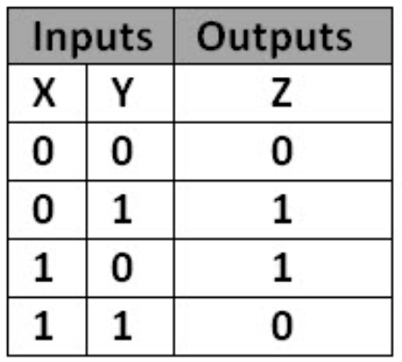
Question 1
11001010 ⊕ 10011010 = 01010000
8734 = 10001000011110 (in binary)
5177 = 01010000111001 (in binary)
8734 ⊕ 5177 = 10001000011110 ⊕ 01010000111001
= 11011000100111
= 13863 (in decimal)

Slide 3
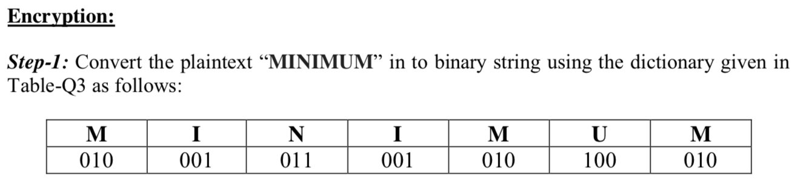
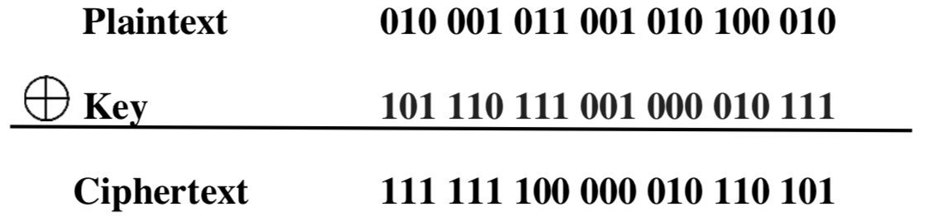
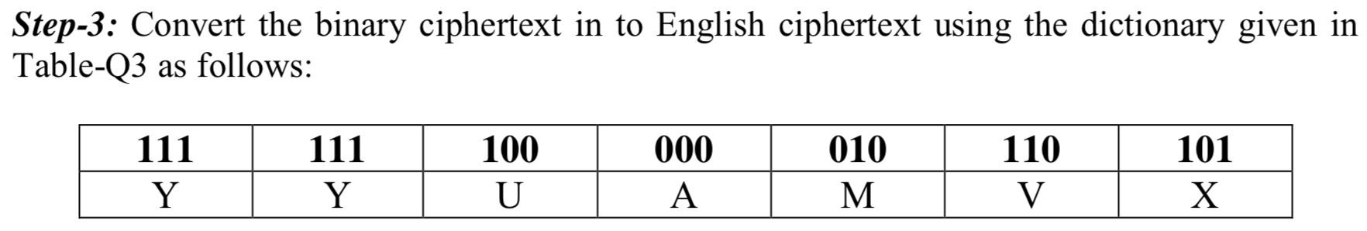
Question 2

Slide 4
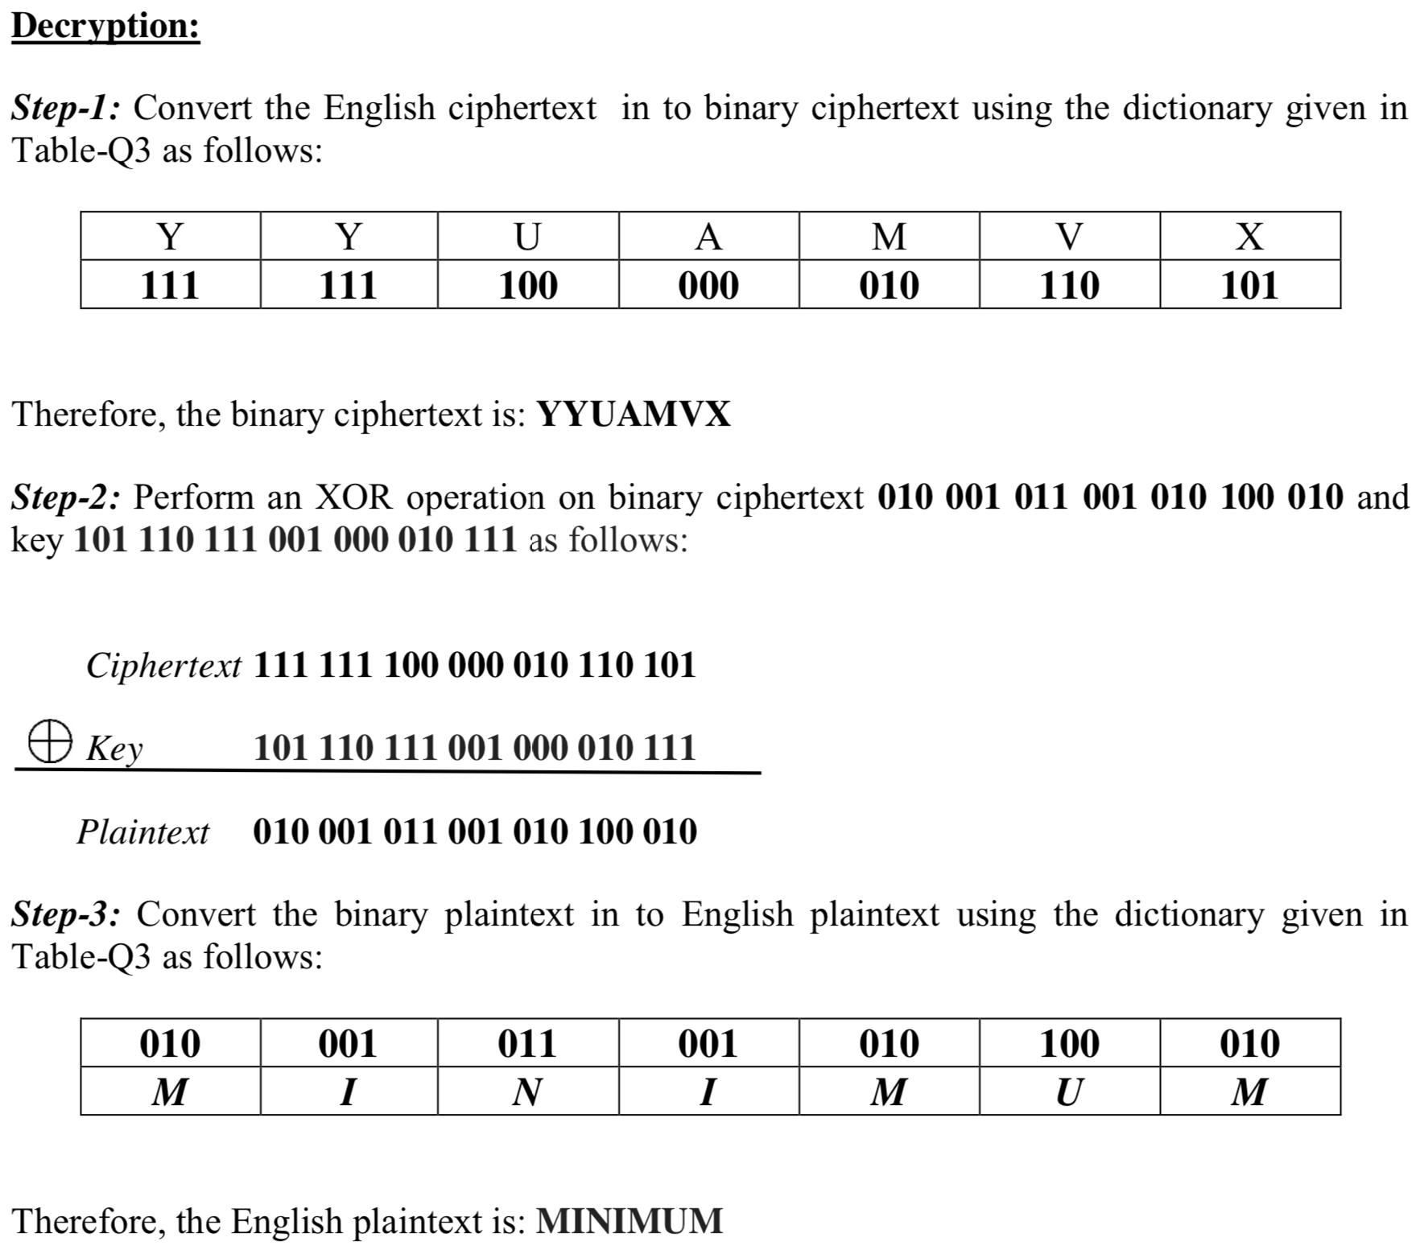
Question 2

Slide 5
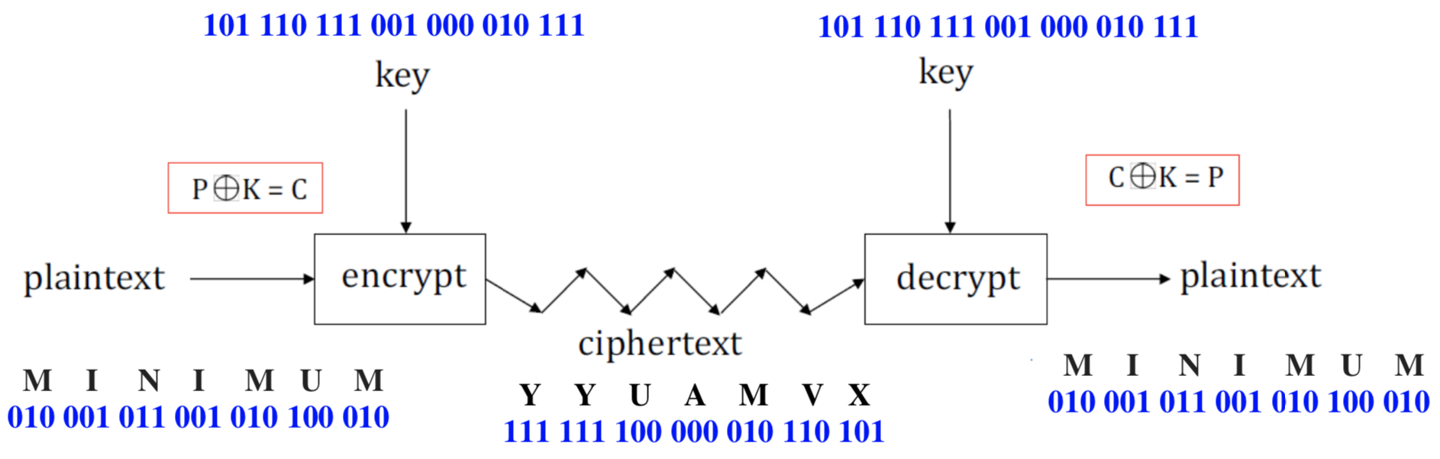
Question 2
Summary of the process:

Slide 6
Question 3
Perfect secrecy requirements:
Every bit in a key must be chosen uniformly at random
The key must have the same size as the message
The key must be used only 1 time
example: One Time Pad
A stream cipher will not be as secure as the one-time pad because:
In stream cipher, the key stream is
not chosen uniformly at random
is relatively short
is used to generate a long keystream by applying an algorithm.
however, stream cipher is still reasonably secure

Slide 7
Question 4
Online bid example (Week 2 Lecture, slide 38)
What properties of a hash function are required for this application?
one-way property
because no one should be able to calculate the bid value given the corresponding hash value
collision-resistance
two different values cannot having the same hash
=> no one can change their bid value after submitting the hash
Question 4b
a forward search attack:
hash all reasonable bids and look for two bids having the same hash as Alice's and Bob's
demo: https://goo.gl/NzsD7N

Slide 8
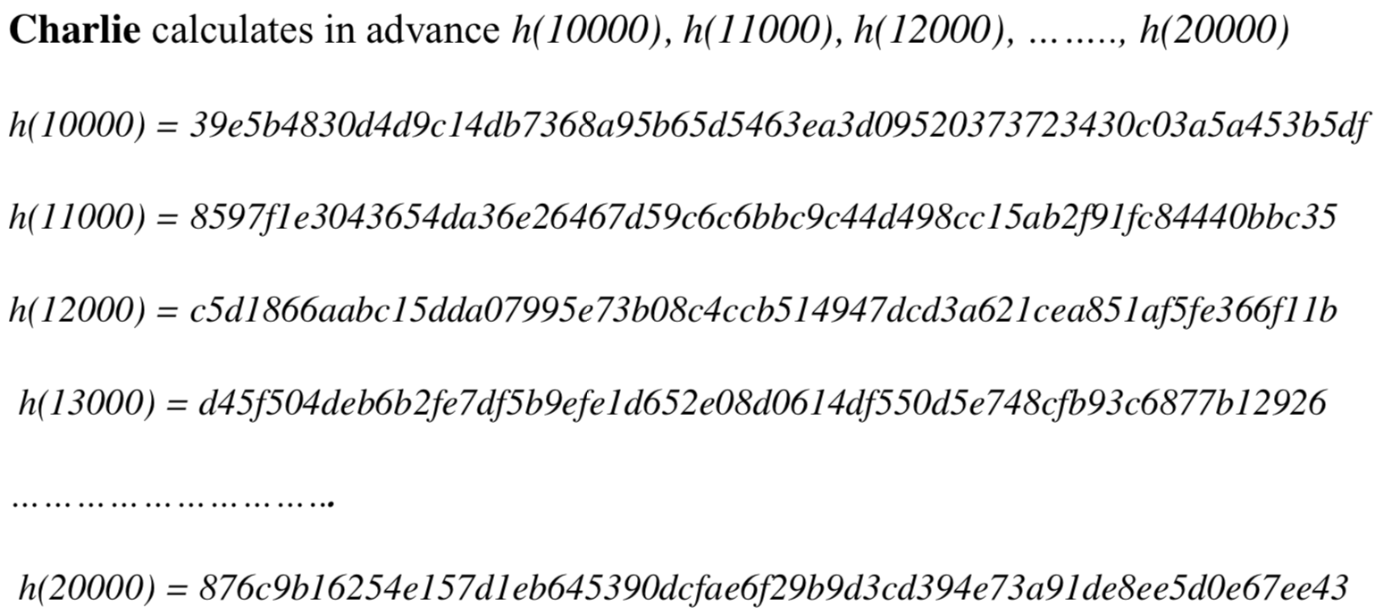
Question 4 (continued)
Attacking the online bid method
Charlie is certain that Alice and Bob will both submit bids between $10,000 and $20,000
Charlie objectives: find out what bid values Alice and Bob sent so that Charlie will send a higher value
what Charlie can do:

Slide 9
Question 4 (continued)
The forward search attack will be successful when:
For example: Alice submits h(11000), and then Bob submits h(12000) using SHA-256
h(11000) = 8597f1e3043654da36e26467d59c6c6bbc9c44d498cc15ab2f91fc84440bbc35
h(12000) = c5d1866aabc15dda07995e73b08c4ccb514947dcd3a621cea851af5fe366f11b
Charlie observes from above list that $11000 and $12000 have been submitted.
Charlie then submits h(13000) to be the winner
h(13000) = d45f504deb6b2fe7df5b9efe1d652e08d0614df550d5e748cfb93c6877b12926
Is the attack in part b a practical security concern?
Yes
How can the bidding procedure be modified to prevent a forward search attack?
Alice can choose a random value R_{A} and submit h(A, R_{A})
Other bidder will do similarly
When revealing her bid, Alice must also reveal her random number R_{A}
Other people can validate h(A, R_{A}) and trust Alice results.

Slide 10
Question 4 (continued)
Preventing forward search attack
Alice chooses a Nonce (random number) RA = 50000 and uses it only one time
Alice adds the random number with original bid 11000 and performs hash
h(11000+50000) = h(61000) = FBF23EFCB4C015694C256068C3D196E9323F40A9993B3E9E4F29B118AD570FEB
Similarly Bob does the same (select another nonce=80000) and performs hash
h(12000+80000)=h(92000)= AD16C1A6866C5887C5B59C1803CB1FC09769F1B403B6F1D9D0F10AD6AB4D5D50
Then they publish the hashes
Charlie cannot guess what the random numbers is because he does not know the Nonce numbers used by Alice and Bob
When revealing the bid, Alice and Bob will also send their Nonce numbers

Slide 11
Link to slide
https://tinyurl.com/y57daa66
Link to Google Sheeet (examples shown in tutorial)
https://docs.google.com/spreadsheets/d/1xrH5kaEIY-N38Wz9aU-O7QaxZEg0FD_hXHMK-QEB8z4/edit?usp=sharing
Link to instructions and my videos about OpenSSL
https://docs.google.com/document/d/1fGGsE9bieOMHVIXl6txs1ES8Rh4jtzYGHnM4IU-BYwI/edit?usp=sharing

